Slide 1
Cyber Security
Lecture 5-6

Slide 2
Removing Malware
Identify symptoms of a malware infection
Quarantine the infected systems
Disable System Restore (if using a Windows machine)
Remediate the infected system
Schedule automatic updates and scans
Enable System Restore and create a new restore point
Provide end user security awareness training
If a boot sector virus is suspected, reboot the computer from an external device and scan it

Slide 3
Preventing from Malware
-Viruses -Worms -Trojans -Ransomware -Spyware -Rootkits -Spam
Worms, Trojans, and Ransomware are best detected with anti-malware solutions
Scanners can detect a file containing a rootkit before it is installed…
removal of a rootkit is difficult and the best plan is to reimage the machine
Verify your email servers aren’t configured as open mail relays or SMTP open relays
Use whitelists and blacklists
Train and educate end users
Update your anti-malware software automatically and scan your computer
Update and patch the operating system and applications regularly

Slide 4
Attack and Defense

Slide 5
Steps of an Attack
The five steps that make up an attack
Probe for information
Penetrate any defenses
Modify security settings
Circulate to other systems
Paralyze networks and devices

Slide 6
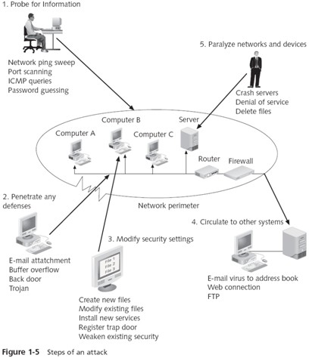

Slide 7
Defenses against Attacks
Although multiple defenses may be necessary to resist an attack. Defenses should be based on five fundamental security Principles:
Layering
Limiting
Diversity
Obscurity
Simplicity

Slide 8
Layering
Information security must be created in layers
One defense mechanism may be relatively easy for an attacker to circumvent
Instead, a security system must have layers, making it unlikely that an attacker has the tools and skills to break through all the layers of defenses
A layered approach can also be useful in resisting a variety of attacks
Layered security provides the most comprehensive protection

Slide 9
Limiting
Limiting access to information reduces the threat against it
Only those who must use data should have access to it
In addition, the amount of access granted to someone should be limited to what that person needs to know
Some ways to limit access are technology-based, while others are procedural

Slide 10
Diversity
Layers must be different (diverse)
If attackers penetrate one layer, they cannot use the same techniques to break through all other layers
Using diverse layers of defense means that breaching one security layer does not compromise the whole system
Example: Diversity: Root DNS Servers

Slide 11
Obscurity
An example of obscurity would be not revealing the type of computer, operating system, software, and network connection a computer uses
An attacker who knows that information can more easily determine the weaknesses of the system to attack it
Obscuring information can be an important way to protect information

Slide 12
Simplicity
Information security is by its very nature complex
Complex security systems can be hard to understand, troubleshoot, and feel secure about
As much as possible, a secure system should be simple for those on the inside to understand and use
Complex security schemes are often compromised to make them easier for trusted users to work with
Keeping a system simple from the inside but complex on the outside can sometimes be difficult but reaps a major benefit
Username and pass printed example:

Slide 13
Summary
Attacks against information security have grown exponentially in recent years
There are several reasons why it is difficult to defend against today’s attacks
Information security may be defined as that which protects the integrity, confidentiality, and availability of information on the devices that store, manipulate, and transmit the information through products, people, and procedures
The main goals of information security are to prevent data theft, thwart identity theft, avoid the legal consequences of not securing information, maintain productivity, and foil cyberterrorism

Slide 14
Summary…
The types of people behind computer attacks are generally divided into several categories
There are five general steps that make up an attack: probe for information, penetrate any defenses, modify security settings, circulate to other systems, and paralyze networks and devices
The demand for IT professionals who know how to secure networks and computers from attacks is at an all-time high

Slide 15
Hands On Project
Write protect enable for removable media
https://www.irongeek.com/i.php?page=security/thumbscrew-software-usb-write-blocker
Scan Computer for botnet
Scan Computer for Rootkit
https://usa.kaspersky.com/downloads/tdsskiller

